Slide 1
Smart-shoes for Physiotherapy Diagnostics
Electronic Design Lab, 2018
Faculty Mentor: Prof. Siddharth Tallur
Teaching Assistants: Dheeraj Kotagiri, Rahul Kumar
Group: DD08
Rohan Pathak 15D070006
Mohak Sahu 15D070047
Suyash Bagad 15D070007

Slide 2
Motivation
Several foot and palm disorders affecting people with intellectual disabilities and have an impact on their ability to mobilise.
Initial diagnosis of such disabilities involves the foot-palm pressure-map analysis
Available Technology: Tekscan’s pressure mapping Mat
Cost: $1700 to $2000, approximately ₹1,15,000 to ₹1,36, 000
User experience: Constrained mobility
The need of a real-time, portable and wireless, low-cost, low-power and easy-to-use device to map plantar pressure for convenient diagnosis by doctors inspired us to take up this project.

Slide 3
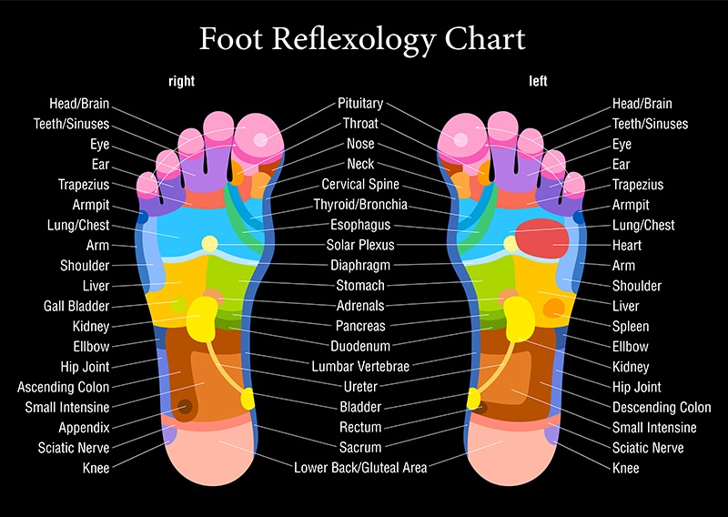
Foot Reflexology Chart
Reference: “Revisiting reflexology: Concept, evidence, current practice, and practitioner training”
Authors: Nurul Haswani, Embong, Yee Chang Soh, Long Chiau Ming and Tin Wui Wongc
Journal of Traditional and Complementary Medicine

Slide 4
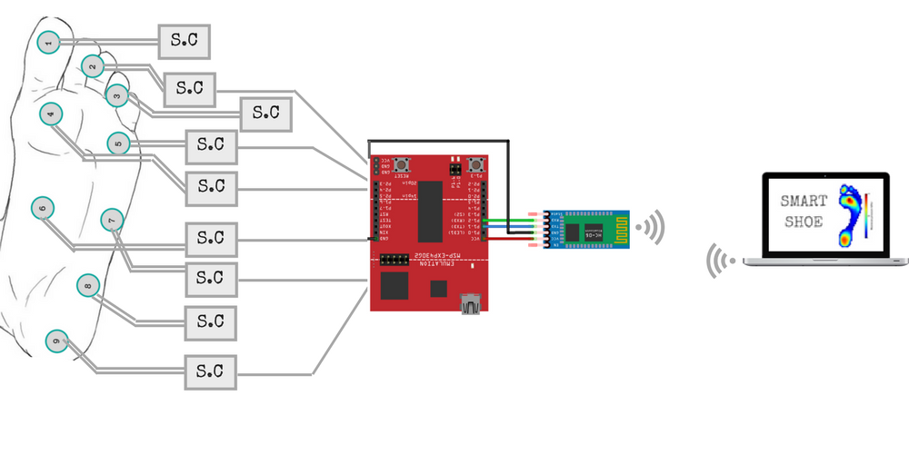
Block Diagram
Sensors
Signal Conditioning
Transmission Block
Receiver host Computer

Slide 5
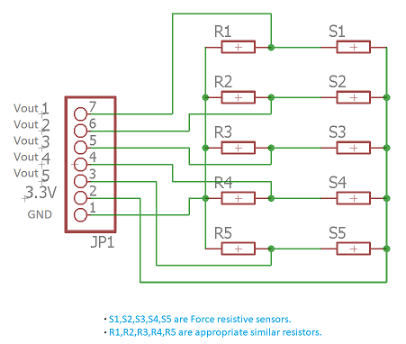
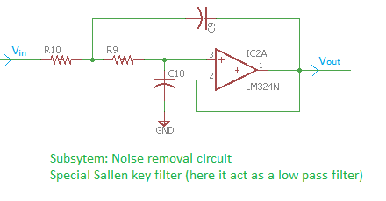
Schematic Diagram of Signal Conditioning
Sensors
Translation Block
Noise removal
ADC (uC)

Slide 6
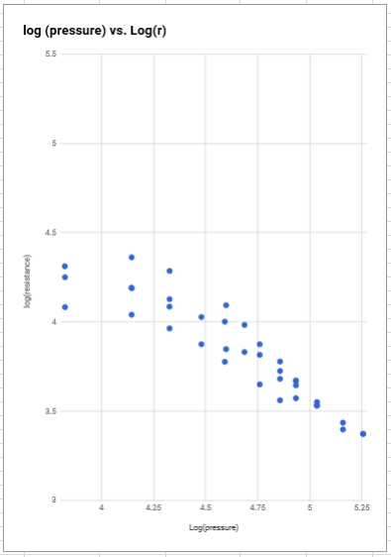
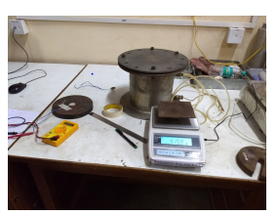
Calibration of Sensors
We used dead weights for calibrating the sensor in steps of 450 grams, from 0 to 8 kgs, followed by unloading.
Calibration Setup
Plot of the log(Resistance) VS log(pressure) values

Slide 7
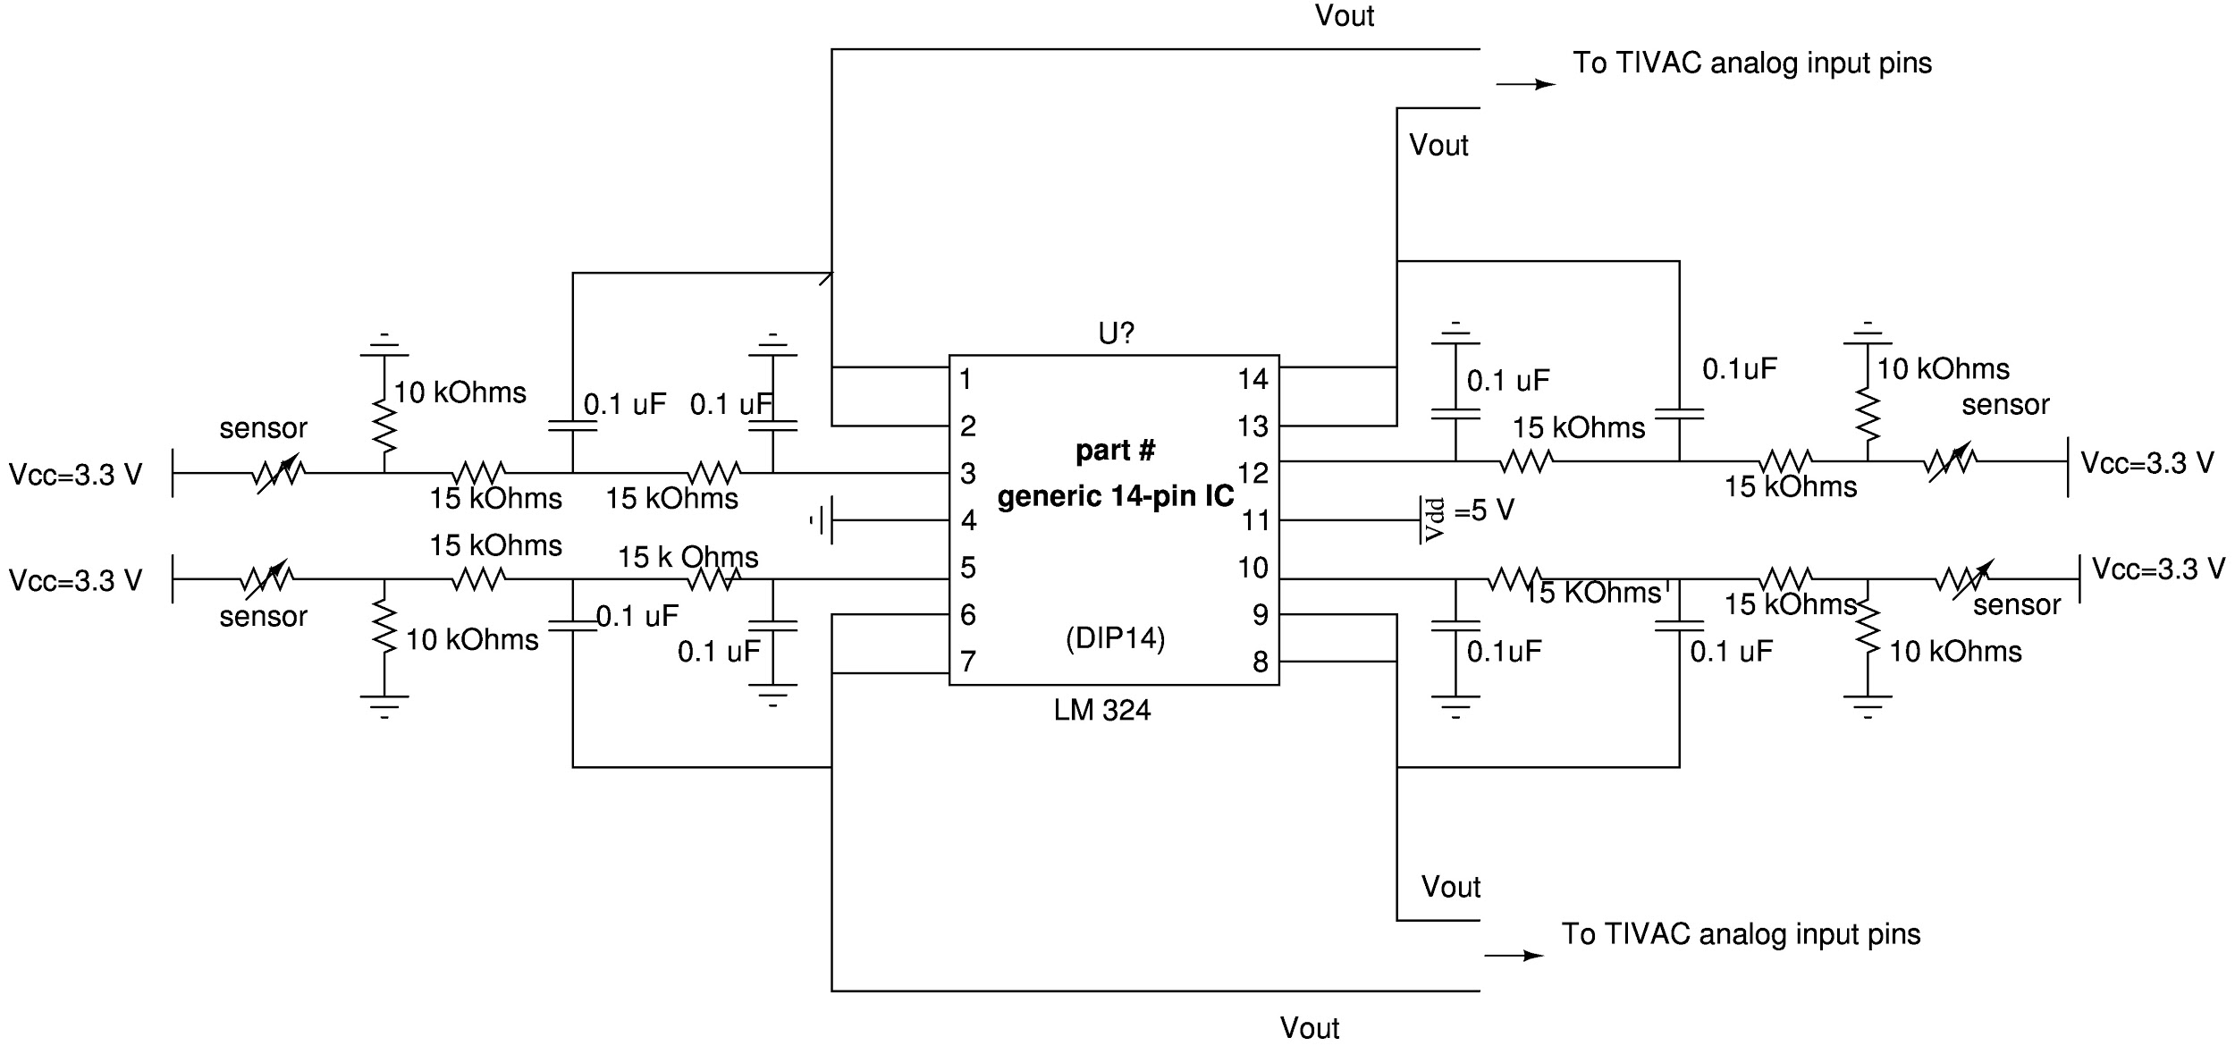
Hardware involved

Slide 8
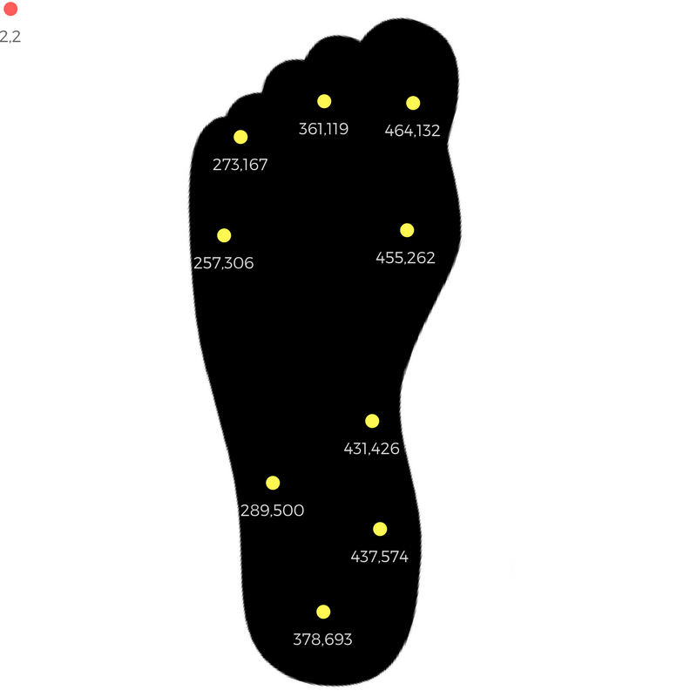
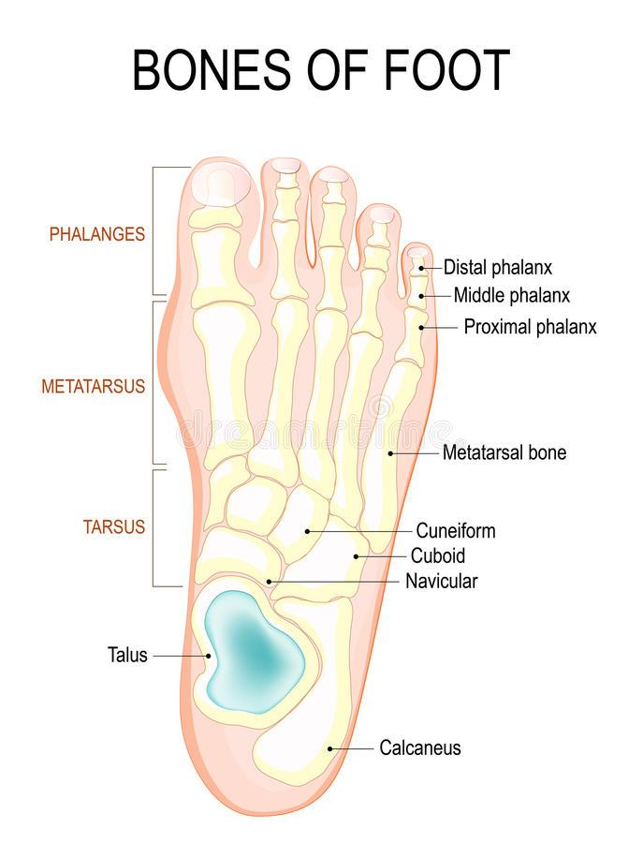

Slide 9
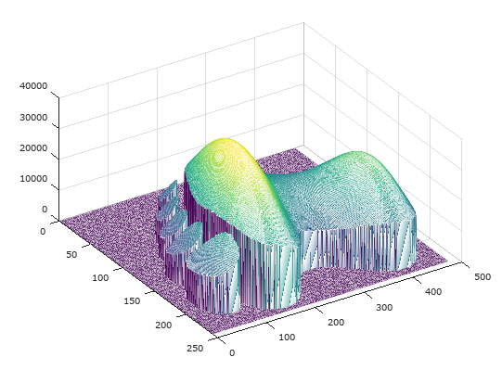
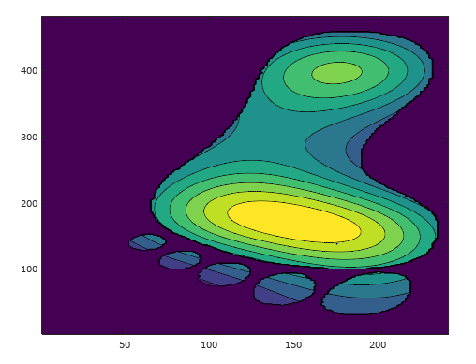
Initial Approach -
Using Matlab for generating Pressure Map
Successfully generated a 2D contour as well as a 3D plot from given data
Drawbacks
It requires around 30 sec to generate the shown two plots
We cannot therefore implement a real time system
To read the values from bluetooth we would need to save the data in a file and then read it from the matlab. Hence, inconvenient.

Slide 10
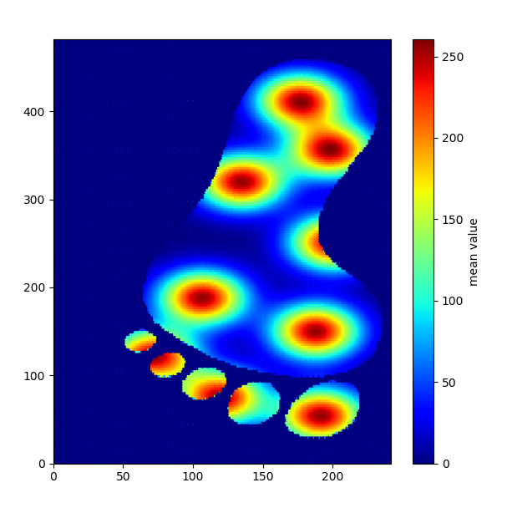
Alternative Solution-
Using Python for generating Pressure Map
We implemented the same in Python which takes around 2 to 3 sec to generate the Pressure Map
Since the map is calculated so rapidly, we can implement a real time system which updates itself after approximately every 3 sec
Further Advantages-
The values from the microprocessor are sent serially to the host PC using Bluetooth module HC05.
The data is directly read in Python using Pyserial Module
So in the same file we can read the data and directly plot the pressure map

Slide 11
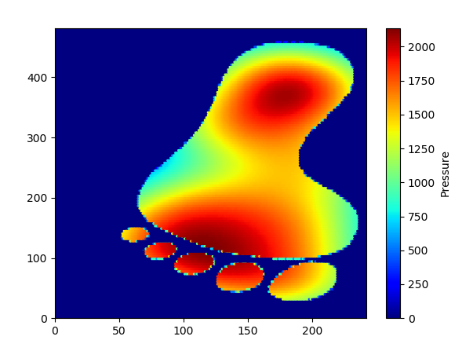
Pressure heat map of a normal heel

Slide 12
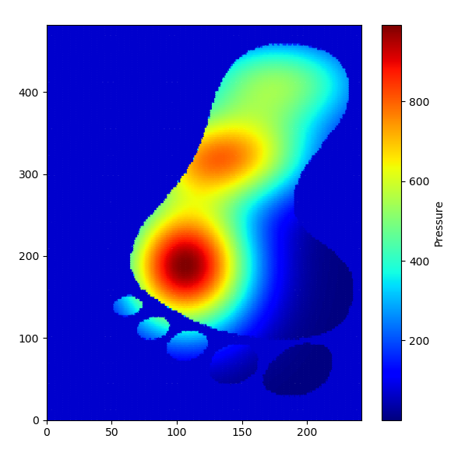
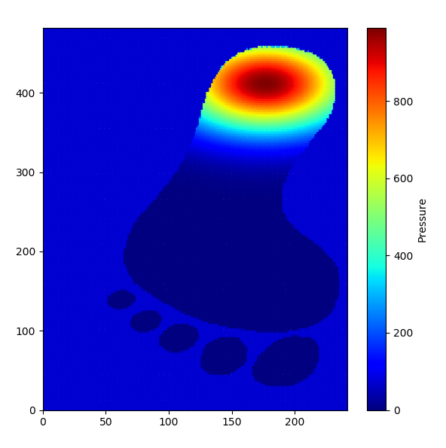
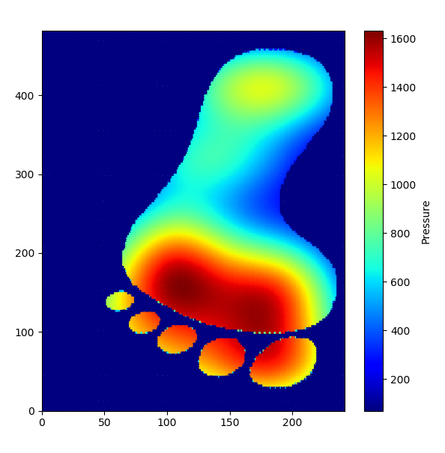
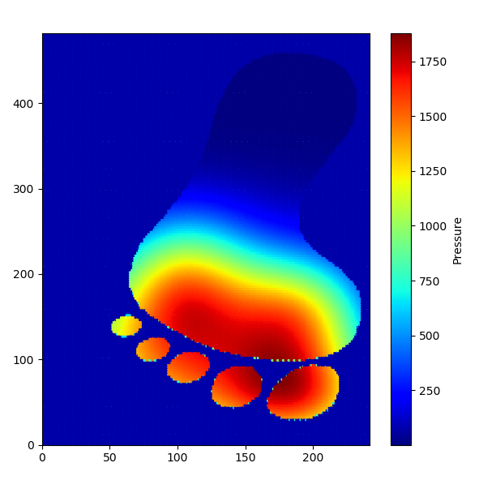
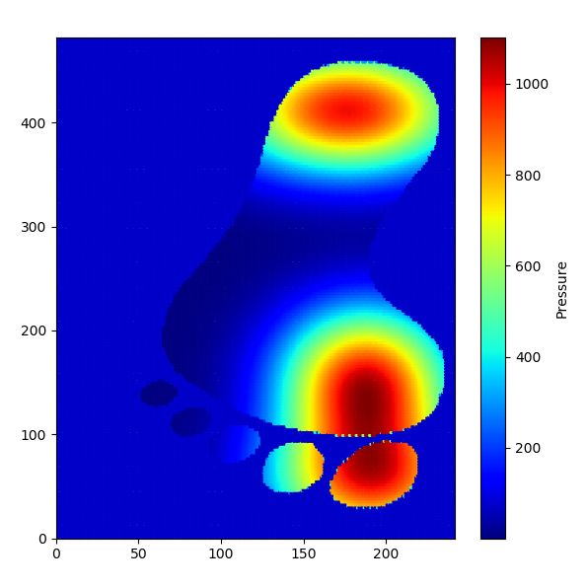
Pressure applied on right metatarsal side
Pressure applied on left metatarsal side
Callus bone dislocation-clubfoot

Slide 13
Pressure applied on heel
Pressure applied on proximal phalanx bone
Clubfoot

Slide 14
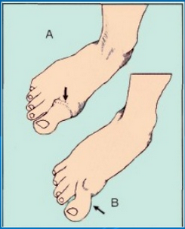
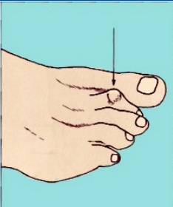
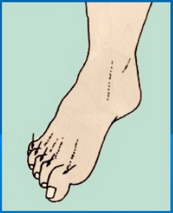
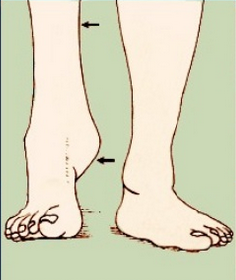
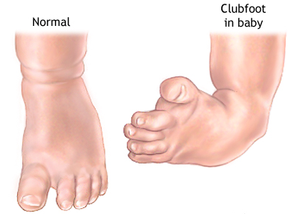
Thickening of big toe
Hammer toe
Claw toe
Flat foot
Clubfoot

Slide 15
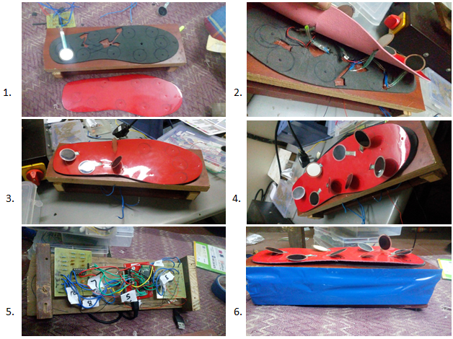
Fabrication Process

Slide 16
Goals for the Demo
Assured Claims:
Make a person of weight less than 50 kg stand on the sensor
Then the pressure sensor values will be processed and sent through the ADC to the host PC via Bluetooth
Plot the steady state pressure map of the foot
Additional objectives which we will try to attain:
Implement a real time system which will update the pressure map approximately every 3 seconds via the bluetooth module

Slide 17




The Team
Suyash Bagad
Rohan Pathak
Mohak Sahu
15D070007
15D070047
15D070006
Thank You !

